Slide 1
PROJECT REVIEW
Title: Phone Directory
Team Members:
Gayathri . I - 727821tuec043,
Gomathi . J - 727821tuec045,
Janani . B - 727821tuec054,
Janani . R.S - 727821tuec055,
Janani. S - 727821tuec056.
Class:
II ECE A

Slide 2
FIGMA
Figma is a collaborative web application for interface design,with additional offline features enabled by desktop applications for macOS and Windows.
It is a design tool that lets you create designs for mobile and web interfaces or any other kind of designs.
It is a collaboration tool for teams and individuals to create and share high-quality work.
It is owned by Dylan Field and Evan Wallace.

Slide 3
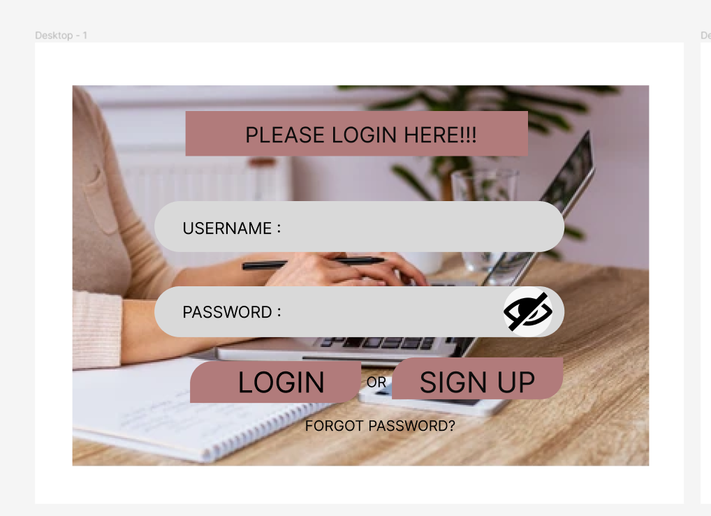
LOGIN PAGE

Slide 4
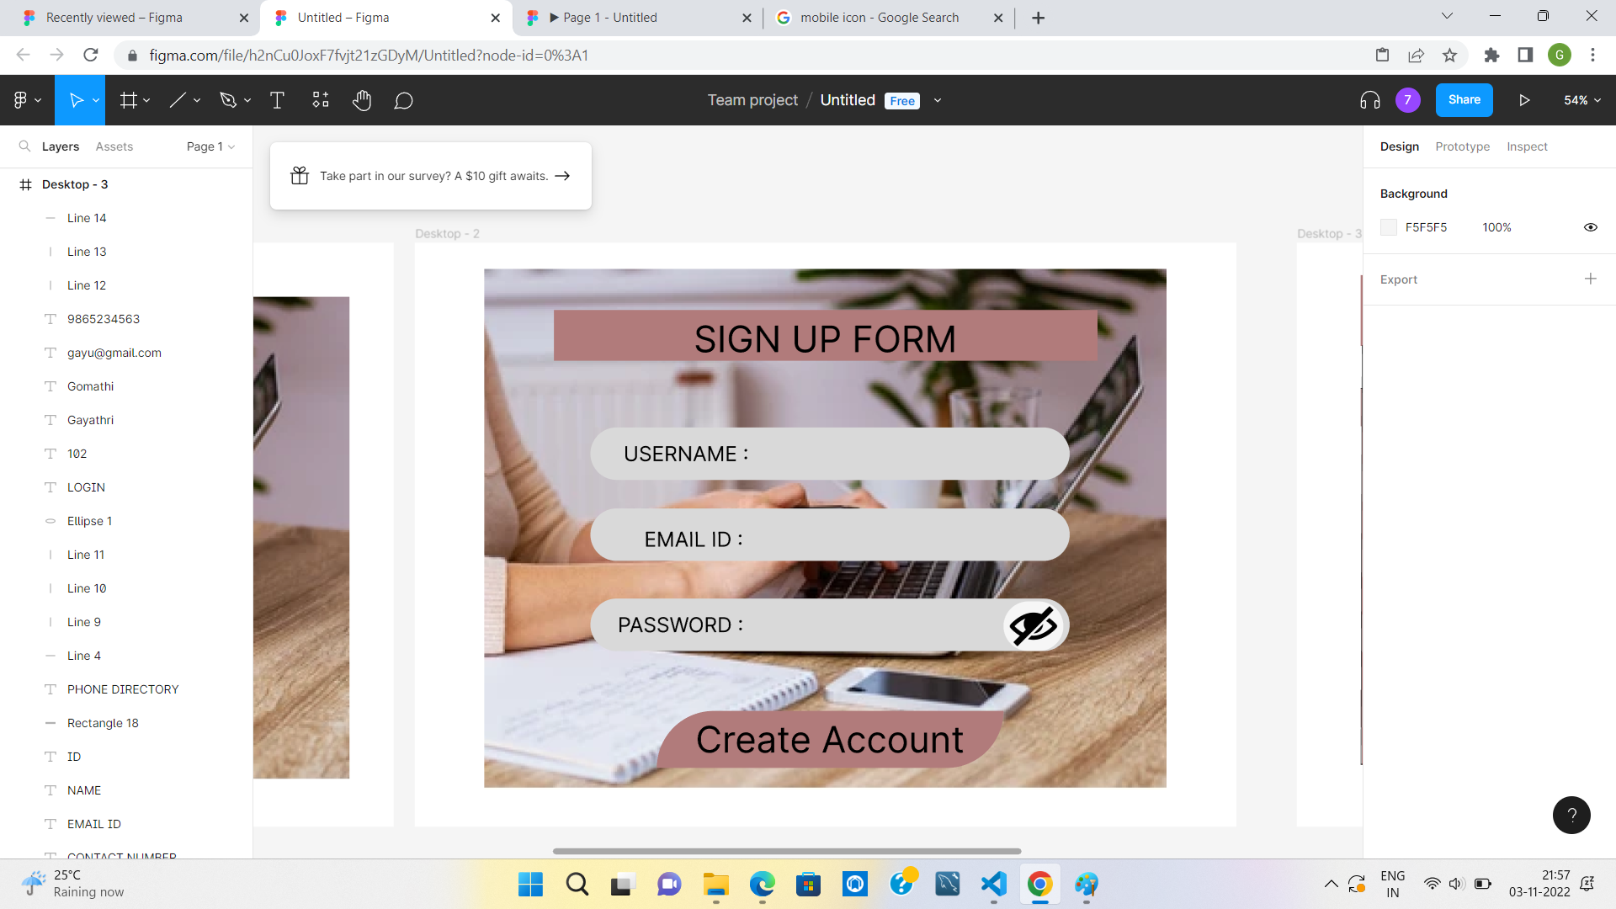
SIGN UP PAGE

Slide 5
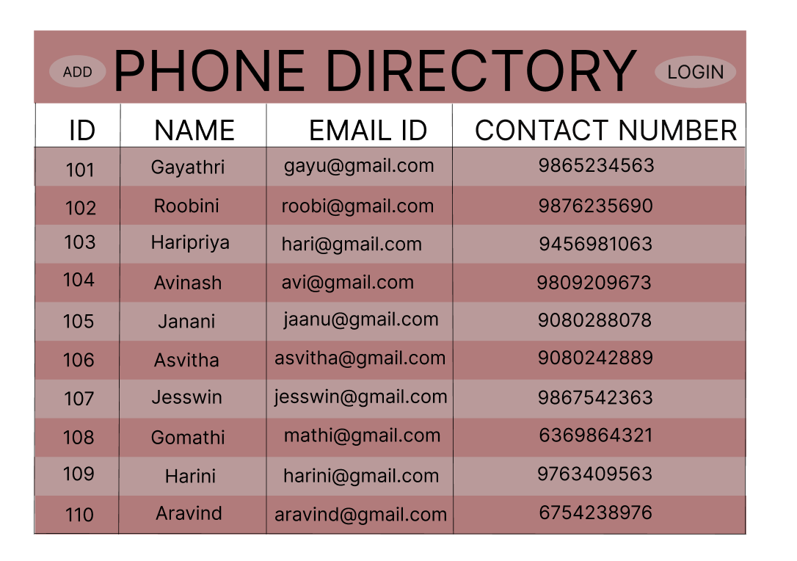
PHONE DIRECTORY

Slide 6
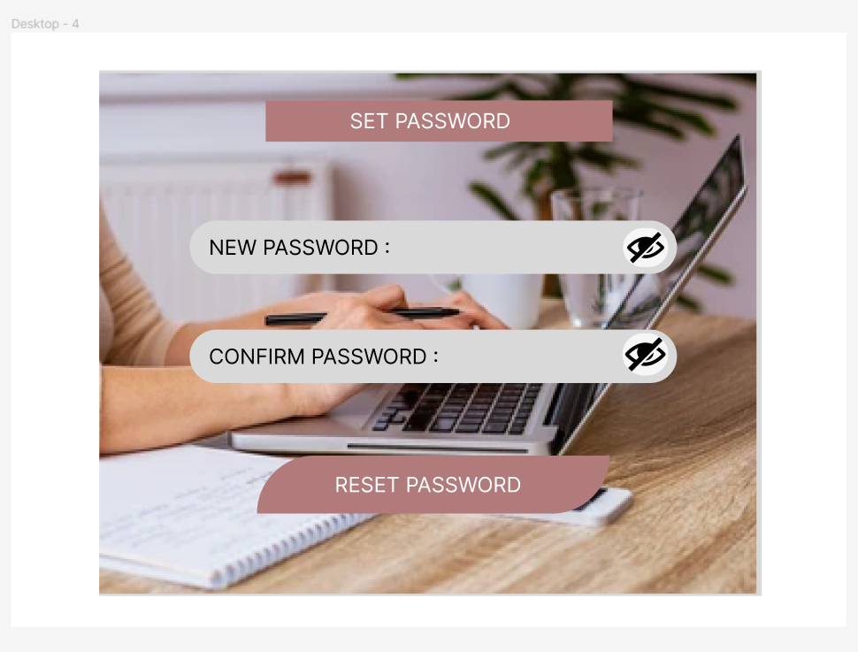
SET PASSWORD PAGE

Slide 7
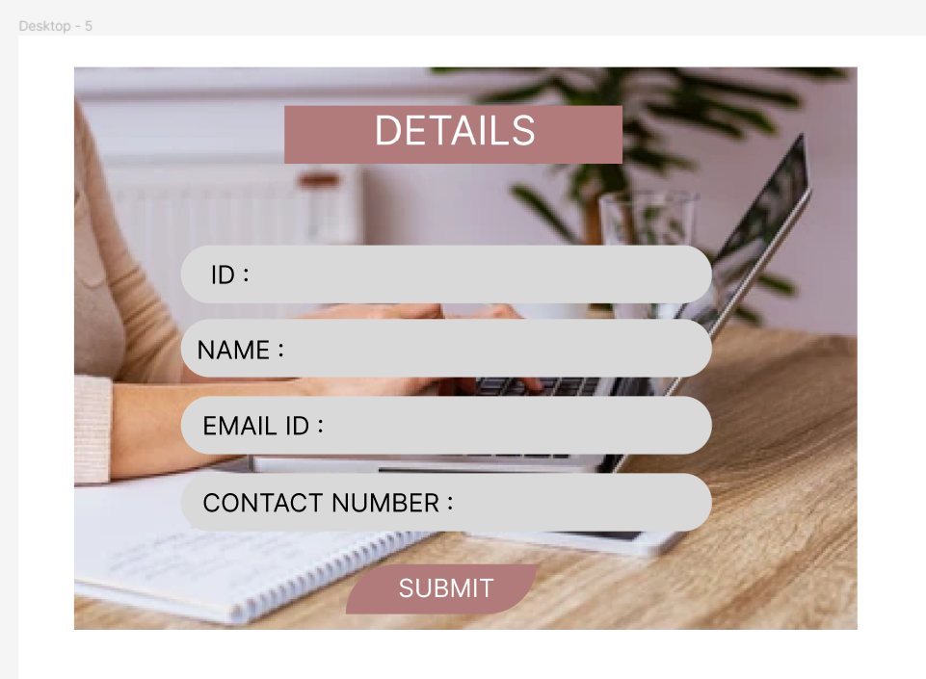
UPDATE PAGE

Slide 8
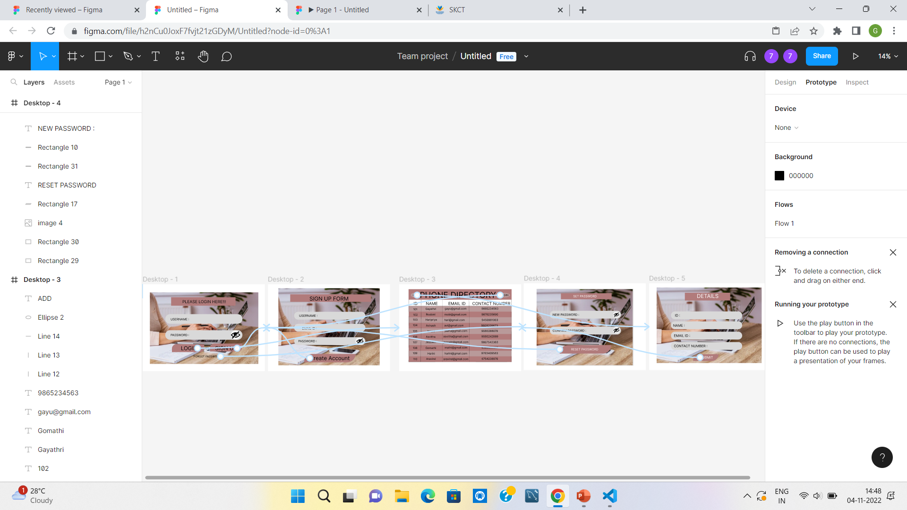
PROTOTYPE

Slide 9
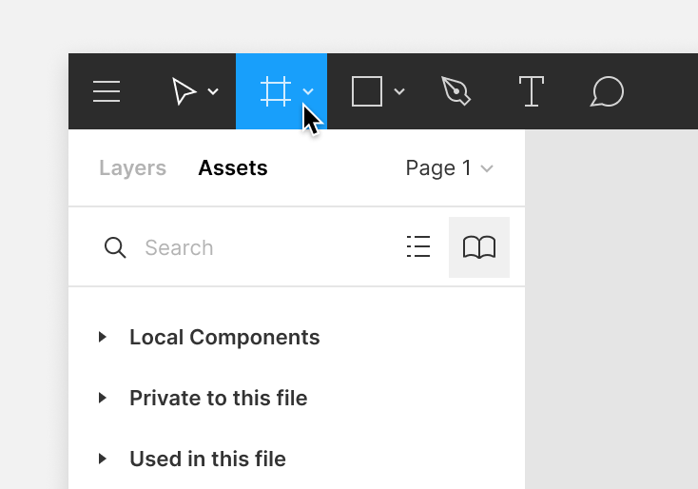
FRAME TOOL
Create frames in the canvas using the frame tool.There are a few ways to select the frame tool:
Use the keyboard shortcuts F or A.
Select the frame tool in the toolbar.

Slide 10
SHAPE TOOL
Shapes make up the majority of your layers in any given design.Figma has some basic shapes you can use as your building blocks.
Rectangle
Line
Arrow
Ellipse
Polygon
Star

Slide 11
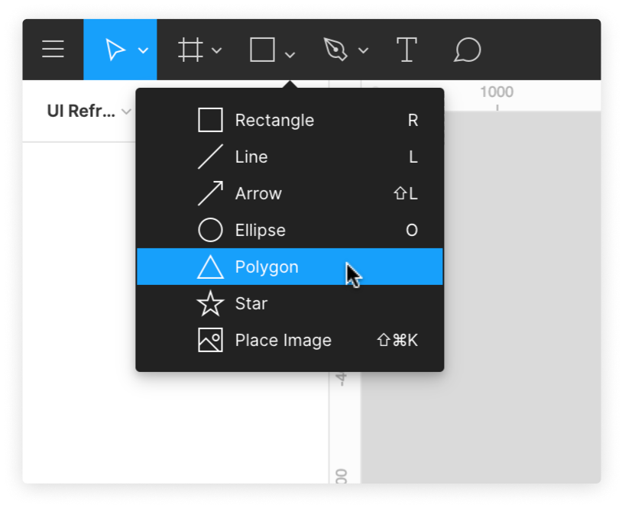
You can access these basic shapes from the shape tools menu in the toolbar.Click the arrow next to the rectangle to open the shape tools menu.

Slide 12
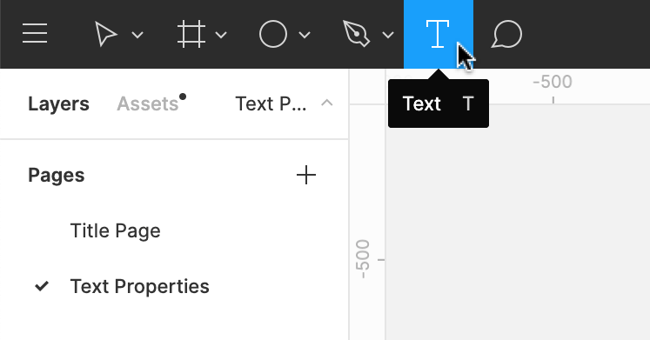
TEXT TOOL
You can create a new text layer using the text tool in the Toolbar.
Once you have the text tool selected,you can create a text layer in the canvas.
Click once in the canvas or,Click and drag in the canvas.

Slide 13
THANK YOU
THE LINK TO MY FIGMA DESIGN IS:
https://www.figma.com/file/h2nCu0JoxF7fvjt21zGDyM/Untitled?node-id=0%3A1
THE LINK TO GITHUB :
https://github.com/gayathriilavarasan/phone-directory.git

